Slide 2
Craftsmanship

Slide 3
“
Code should be easy to reason about ~ Some genius ~

Slide 4
Single Value Object

Slide 5
»
Equal by value (by definition) Immutable Valid (no rubbish) Scalar/primitive Encapsulated (do not share the internals)

Slide 6
»
Equal by value Immutable (by consequence) Valid (no rubbish) Scalar/primitive Encapsulated (do not share the internals)

Slide 7
»
Equal by value Immutable Valid (no rubbish) Scalar/primitive Encapsulated (do not share the internals)

Slide 8
»
Equal by value Immutable Valid It should be tiny (Scalar/primitive) Encapsulated (do not share the internals)

Slide 9
»
Equal by value Immutable Valid It should be tiny Encapsulated (don’t share internals)

Slide 10
“
Encapsulation is important, but the reason why it is important is more important. Encapsulation helps us reason about our code. In well-encapsulated code, there are fewer paths to follow as you try to understand it. It isn’t an end in itself; it is a tool for understanding. ~ Michael C. Feathers ~

Slide 11
Konrad Zuse

Slide 12
Contract clarity

Slide 13
}
interface Contract { string Email { get; } DateTime DateOfBirth { get; } decimal Price { get; } string Currency { get; } decimal BonusPercentage { get; } }

Slide 14
}
interface Contract { string EmailAddress Email { get; } DateTime DateOfBirth { get; } decimal Price { get; } string Currency { get; } decimal BonusPercentage { get; } }

Slide 15
}
interface Contract { EmailAddress Email { get; } DateTime DateOfBirth { get; } decimal Price { get; } string Currency { get; } decimal BonusPercentage { get; } }

Slide 16
}
interface Contract { EmailAddress Email { get; } Date DateOfBirth { get; } decimal Money Price { get; } string Currency { get; } decimal BonusPercentage { get; } }

Slide 17
}
interface Contract { EmailAddress Email { get; } Date DateOfBirth { get; } Money Price { get; } decimal Percentage BonusPercentage { get; } }

Slide 18
Units

Slide 19
“
The Mars Climate Orbiter robotic space probe launched by NASA on December 11, 1998 to study the Martian climate and atmosphere. However, on September 23, 1999, communication with the spacecraft was lost as the spacecraft went into orbital insertion, due to ground-based computer software which produced output in non-SI units of pound-force seconds (lbf·s) instead of the SI units of newton-seconds (N·s) specified in the contract between NASA and Lockheed. $125 million was lost.

Slide 20
}
double price = 520.50; double discount = 20.00; double total = price - discount; // 500.50

Slide 21
}
Money price = 520.50 + Currency.EUR; Money discount = 20.00 + Currency.EUR; Money total = price - discount; // 500.50 EUR

Slide 22
}
Money price = 520.50 + Currency.USD; Money discount = 20.00 + Currency.EUR; Money total = price - discount; // throws currency mismatch

Slide 23
Normalization

Slide 24
}
[TestCase("grr")] [TestCase("GRR")] [TestCase("G. R. R.")] public void Parsing_initials_normalizes_input(string input) { var expected = Initials.Parse("G.R.R."); var initials = Initials.Parse(input); Assert.AreEqual(expected, initials); }

Slide 25
}
var percentage_0 = double.Parse("12.5%"); var percentage_1 = double.Parse("12.5"); Assert.AreNotEqual(percentage_0, percentage_1);

Slide 26
}
var percentage_0 = Percentage.Parse("12.5%"); var percentage_1 = Percentage.Parse("12.5"); Assert.AreEqual(percentage_0, percentage_1);

Slide 27
Formatting

Slide 28
}
var size = StreamSize.FromMegabyte(12.5); size.ToString("0.00 F"); // 12.50 Megabyte size.ToString("#,##0 kB"); // 12,500 kB

Slide 29
Validation

Slide 30
}
struct Iban { static Iban Parse(string str) { var norm = Normalize(str); return MatchPattern(norm) && ValidForCountry(norm) && Mod97(norm) ? new Iban(norm); : throw new FormatException("Not a valid IBAN."); } }

Slide 31
Anti-corruption layer

Slide 32
}
void Store(DateTime dateOfBirth) { var command = CreateCommand(); command.AddParameter("dateOfBirth", dateOfBirth.Date); }

Slide 33
}
void Store(DateTime dateOfBirth) { var command = CreateCommand(); command.AddParameter("dateOfBirth", dateOfBirth.Date); }

Slide 34
}
void Store(Date dateOfBirth) { var command = CreateCommand(); command.AddParameter("dateOfBirth", dateOfBirth); }

Slide 35
}
async Task<decimal> Balance(string iban, …) { Guard.IsIban(iban); var response = await Client.PostAsync(new Request { Iban = iban.Remove(" ", string.Empty).ToUpper(), … } }

Slide 36
}
async Task<decimal> Balance(Ibanstring iban, …) { Guard.IsIban(iban); var response = await Client.PostAsync(new Request { Iban = iban.Remove(" ", string.Empty).ToUpper(), … } }

Slide 37
}
async Task<decimal> Balance(Iban iban, …) { var response = await Client.PostAsync(new Request { Iban = iban, … } }

Slide 38
Domain logic

Slide 39
}
Percentage factor = Percentage.Parse("13.6%"); Percentage factor = (Percentage)0.136; Percentage factor = 13.6.Percent(); // 13.6%

Slide 40
}
Money bruto = 50 + Currency.EUR; Money netto = bruto + 10.Percent(); // 55 EUR Area garden = 8.6.meter() * 2.3.meter(); // 27.52m²

Slide 41
}
double rounded = Math.Round(0.1368, 1); // 0.1 Percentage rounded = 13.68.Percent().Round(1); // 13.7%

Slide 42
}
EmailAddress mail = EmailAddress.Parse("root@[127.0.0.1]"); Assert.IsTrue(mail.IpBased);

Slide 43
Serialization

Slide 44
}
20.5.Percent().ToJson(); // 20.5?

Slide 45
}
20.5.Percent().ToJson(); // 0.205

Slide 46
}
20.5.Percent().ToJson(); // '20.5%'

Slide 47
Reusage

Slide 48
“
Code reuse is the Holy Grail of Software Engineering. ~ Douglas Crockford ~

Slide 49
The Challenge

Slide 50
“There ain’t
no such thing as a
free lunch”

Slide 51
Serialization

Slide 52
}
struct MySvo : IXmlSerializable { void ReadXml(XmlReader reader) { this.val = Parse(reader.ReadElementString()).val; } }

Slide 53
}
struct MySvo : IXmlSerializable { void IXmlSerializable.ReadXml(XmlReader reader) { this.val = Parse(reader.ReadElementString()).val; } }

Slide 54
}
struct Percentage { object ToJson() => val.ToString("0,#%", Culture.Invariant); static Percentage FromJson(string json) => Parse(json, Culture.Invariant); static Percentage FromJson(double json) => new((decimal)json); }

Slide 55
Equality

Slide 56
}
export class DateOnly { public equals(other: any): Boolean { … } }

Slide 57
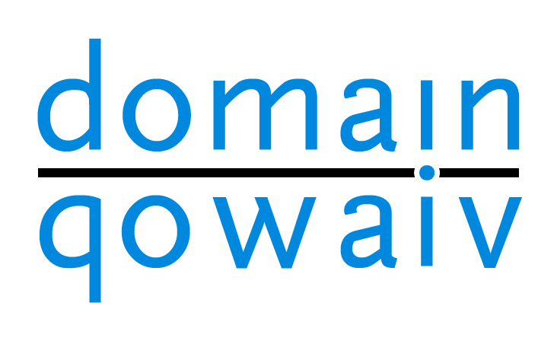

Slide 58
»
Open Source (github.org/Qowaiv, MIT) Package (nuget.org/packages/Qowaiv) Code Generation Percentage, Money, Date, PostalCode, DateSpan, EmailAdress, … JSON, TypeConversion, XML, IFormattable, IComparable Reliable (Exact Software, ABN-AMRO Bank, …)

Slide 59
Primitive Obsession

Slide 60
“
Primitive obsession is using primitive data types to represent domain concepts. By doing so, meaning is obfuscated at best, or lost in worst cases. ~ Corniel Nobel ~

Slide 61
»
No limitations on primitive No formatting/normalization Lack of domain specific methods

Slide 62
Take-away

Slide 63
»
SVO’s give meaning to your code SVO’s can be reused in most cases Using SVO’s comes with a cost Sometimes it is not worth the effort

Slide 64
»
github.com/corniel linkedin.com/in/corniel-nobel/ mail@corniel.nl

Slide 65
Questions

